Slide 1
The Cold War

Slide 2
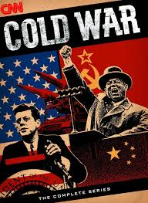
Tensions After WWII
After WWII a fierce struggle for power ensued between two super powers
USA vs. USSR
This struggle for power is known as the Cold War
USA left WWII stronger than it had ever been
The USSR left with greater importance and power

Slide 3
Things fell apart during the conferences of WWII
Both nations were too different from each other
American industry and economy boomed during WWII
  Took virtually no losses back home during war
Soviet industry was destroyed
  28 Million dead
  Felt bitter

Slide 4
Fearful and scarred from the war, Soviets tried to secure their own safety
Wanted to protect itself from further attacks
Russia wanted to take land in the West to make a buffer zone
Wanted to spread communism to spread unity to these areas
  Gov seized private land and take charge for agricultural production
https:/www.youtube.com/watch?v=tLJKVVtiR3g/

Slide 5
The U.S was also worried about their own security
Pearl Harbor was the first attack by a foreign nation in the country in a long time
Wanted to prevent hostile powers from taking land in Eurasia like they had in WWII
Maintain a strong military presence overseas
  Set up new bases all across Europe and Asia

Slide 6
The U.S was actively promoting free trade globally
Spread democratic capitalism all over the world
Soviets wanted to spread communism all over the world
This ideological difference sparked the main conflict in the Cold War
  Communism vs. Democracy

Slide 7
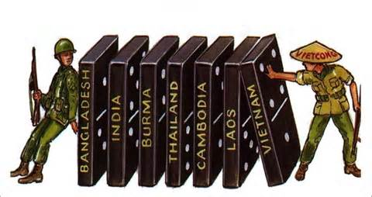
Eastern Europe
Stalin promised self determination in Eastern Europe
  Countries would chose gov for themselves
Stalin withdrew that pledge and personally made sure pro-communist governments were in place
  Poland, Bulgaria and Romania
U.S and GB began fearing Stalin as a threat
Domino Theory: theory that communism would spread from Eastern Europe into Asia

Slide 8
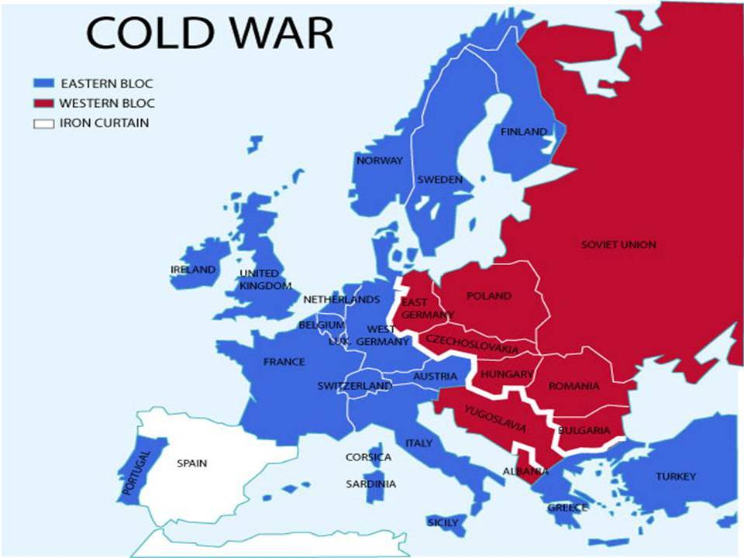
Winston Churchill—”An iron curtain has descended across the continent”
Iron Curtain: came to symbolize the division of the democratic Western Europe and the communist Eastern Europe
https://www.youtube.com/watch?v=S2PUIQpAEAQ
Stalin said Churchills accusation was an act of war

Slide 9
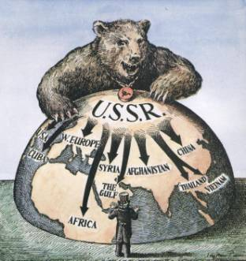
U.S realized that the Soviets would spread communism as far as they could
Containment: U.S and Western nations policy to stop the spread of communism and spread democracy
Soviets were trying to take Turkey and Greece
Truman sent aid to Turkey and Greece to purposefully set up democracy
Truman—”We must assist free peoples to work out their own destinies in their own way”

Slide 10
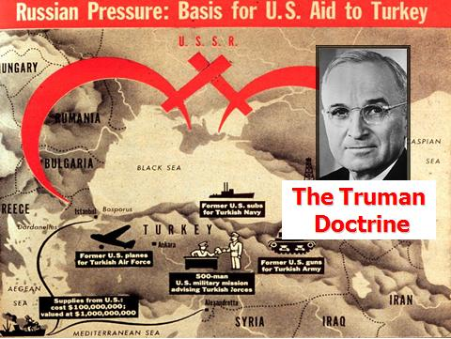
Truman Doctrine & Marshall Plan
Truman Doctrine: principle of providing support and aid to free countries while containing communism during Cold War
George Marshall: Secretary of State who proposed aid package to aid Europe after WWII
Marshall Plan: U.S. aid plan designed to promote economic recovery in post war Europe
Soviets prohibited Eastern Europe from receiving help
  Feared a democratic undermining

Slide 11
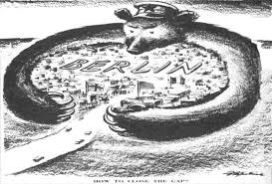
Berlin
Marshall Plan provided 13 billion dollars in aid to Western Europe
Helped promote economic growth, democratic political stability
Western Allies (GB, France, U.S.) planned to combine their 3 German zones
Stalin was angered by this and blockaded the western sectors
Berlin was inside the Soviet zone but had been divided into zones itself
West Berlin was cut off from the Western Zones
https://www.youtube.com/watch?v=cH-GVf9floo

Slide 12
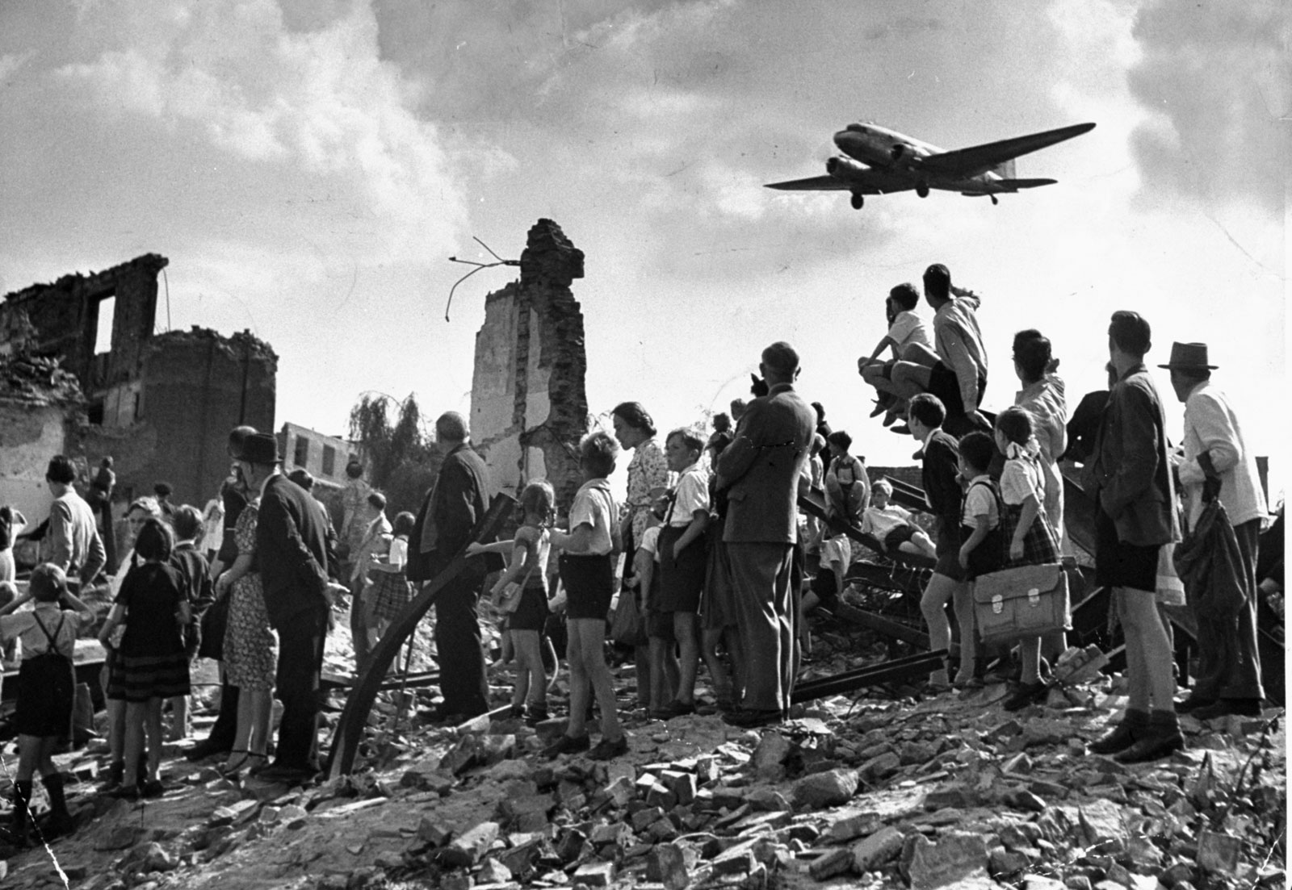
Berlin
West Berlin was cut off from all supplies
Stalin wanted to starve the city into submission and force the Allies to give up plan to combine zones
U.S. organized the Berlin Airlift
  Flew food and essentials over blockade into Berlin
After a year Stalin ended the blockade
Germany split into two nations

Slide 13
Berlin
The Federal Republic of Germany (aka West Germany) consisted of the three democratic zones
The German Democratic Republic (aka East Germany) was under Soviet control

Slide 14
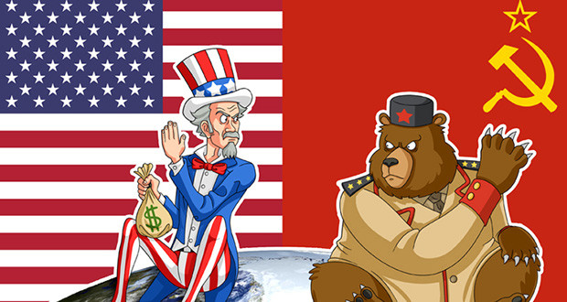
Cold War Intensifies
By 1949 the two sides were clearly plotted against each other economically, politically and socially
Europe was divided into democratic west and communist east
Each side fought each other through economic policy, diplomatic policy, propaganda, espionage and secret ops
No shooting took place but violence was a consistent threat

Slide 15
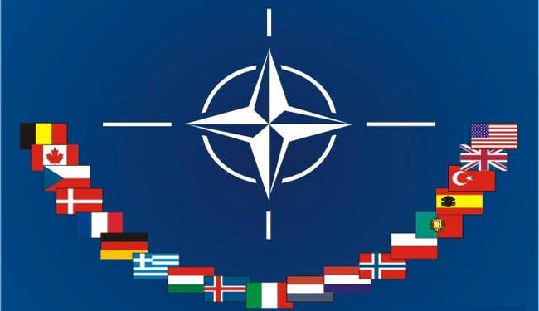
NATO
In 1949 the Western Allies formed NATO
North Atlantic Treaty Organization
Included U.S., Canada, and Western Europe
Dedicated to a mutual defense of one another against the Soviets
An attack on one country=an attack on all

Slide 16
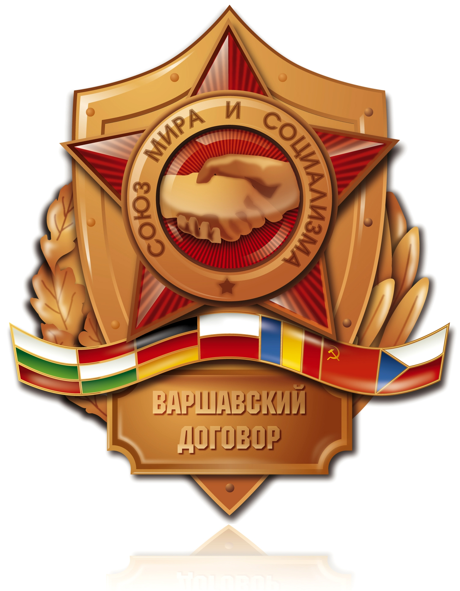
Warsaw Pact
Soviet Union formed their own alliance 6 years after NATO
Warsaw Pact: Soviet alliance system with Eastern European countries
Both alliances increased military tension between each other

Slide 17
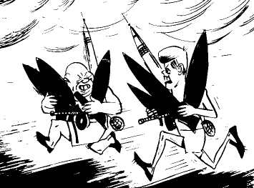
Arms Race
Nuclear weapons were a huge threat
U.S.A showed might of A-bomb on Japan
Soviets successfully tested an A-bomb in 1949
By the early 1950’s both countries had hydrogen bombs
By 1960’s they had inter-continental ballistic missiles
  Could carry a warheads a continent away
  https://www.youtube.com/watch?v=lC9Sd2Gi404

Slide 18
Arms Race
Both super powers were engaged in an expensive battle over weapons
Arms Race: competition over achieving and having the largest quantity of superior weapons
The race fueled the fears of citizens of a nuclear war

Slide 19
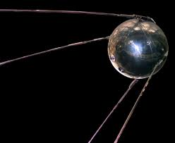
Space Race
Sputnik: 1957 Soviets launched the worlds first satellite
U.S. launched its own a few months later
1961 the Soviets send the first astronaut into orbit
America followed soon with their own astronaut
In 1969 the U.S landed on the moon
In 1960 Soviets shot down a U.S. U-2 spy plane increasing tensions

Slide 20
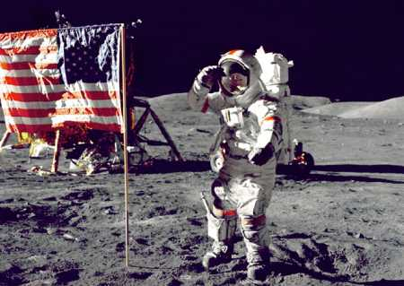
Both the space race and arms race were extremely expensive
Both brought about huge gains in the worlds of science and technology

Slide 21
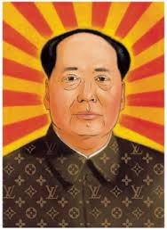
China in the Cold War
After WWII China was torn by a civil war
Communists vs. Nationalists
Mao Zedong was communist leader
He won in 1949 and created the People Republic of China
Nationalists fled to Taiwan and set up their own government
Mao soon allied with the Soviet Union

Slide 22
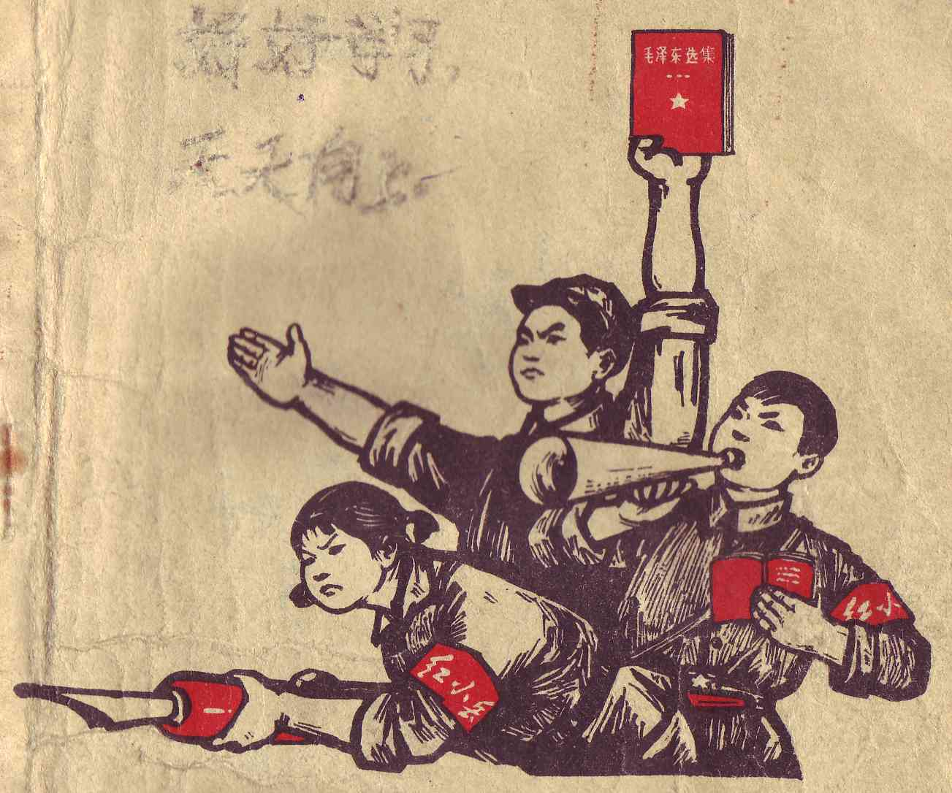
China
China took public land and divided it between peasants to work for gov
Wanted a cultural revolution to build a society of peasants and workers
Red Guards: violent radical group who closed schools and executed many people
Red Guards spread violence to force people to submit to communism

Slide 23
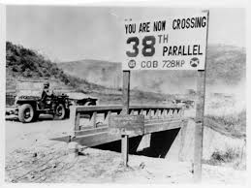
Korean War
Korea was divided into two nations, North Korea and South Korea
North Korea was backed by the soviets
South Korea was backed by the U.S.
The 38th Parallel divided the two nations

Slide 24
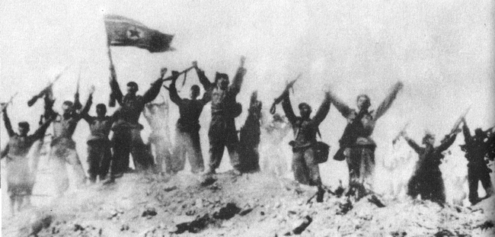
Korean War
The 38th Parallel turned into a standoff in 1950
N. Korea invaded S. Korea in 1950 with Soviet support
S. Korea reached out to the newly formed United Nations for help
This was the UN’s first test
  UN sends troops from 15 nations to help S. Korea
Douglas MacArthur led the UN force against the N. Koreans

Slide 25
North Korea controlled most of the peninsula when MacArthur’s troops
MacArthur’s troops gain ground
Half of N. Korea’s army surrenders the rest retreats back to N. Korea
UN troops push N. Korea almost into the Chinese border
China sends 300,000 troops and capture Seoul
MacArthur calls for a nuclear attack and is removed from command
1953, a cease fire is signed and the borders are re-established at 38th parallel

Slide 26
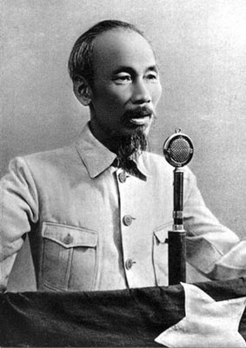
War in Vietnam
Ho Chi Minh: Vietnamese nationalist and communist leader
Vietnam was a French colony
In 1954 the French surrendered to the Vietnamese after they were defeated
Vietnam is divided into communists and anti-communists
Ngo Dinh Diem leads anti-communist gov in South Vietnam
Vietcong: S. Vietnamese fighting against Diem

Slide 27
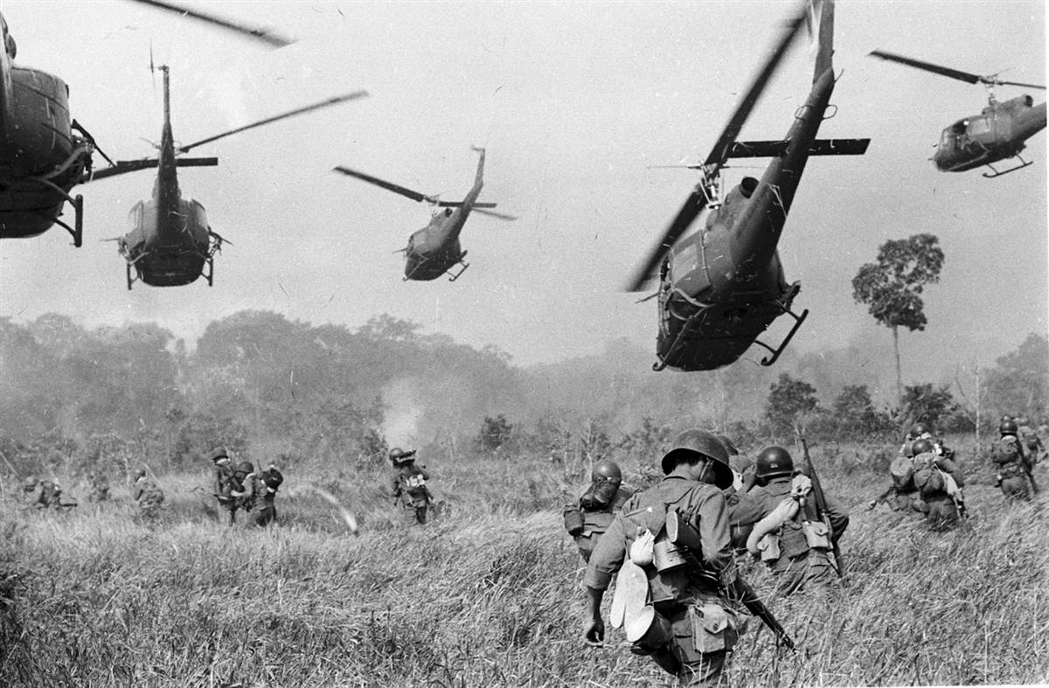
The U.S. Enters into Vietnam
In 1964 the U.S. sent troops to fight N. Vietnamese and Vietcong
Guerilla warfare made the war very difficult
N. Vietnam and Vietcong are backed by Ho Chi Minh, China and USSR
War was increasingly unpopular in U.S.
In 1969 President Nixon began withdrawing troops

Slide 28
Vietnamization: Nixon’s plan to withdraw troops gradually over time
Last U.S. troops leave in 1973
By 1975 the resistance in S. Vietnam is overrun
58,000 Americans were killed

Slide 29
Postwar Asia
Vietnam’s capital of Saigon was named Ho Chi Minh City and was communist
1.5 million Vietnamese fled to other nations including U.S. and Canada
In 1995 the U.S. restored relations with Vietnam

Slide 30
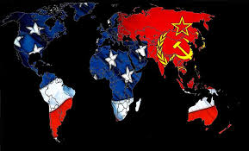
Fighting for Control
The western allied democratic nations and eastern allied communist nations fought over the “third world”
Developing nations were easy targets to spread their influence
They backed revolutions and government coups to spread their beliefs
Gave economic aid, military aid and technological aid to struggling countries

Slide 31
Fighting for Control
Some countries wanted nothing to do with the Cold War
  Like India
Nonaligned nations: nations who do not get involved in the Cold War and remain neutral

Slide 32
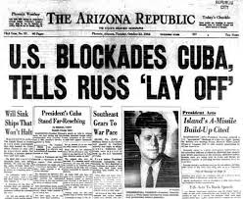
Latin America
Fidel Castro led a Cuban communist revolution
U.S. supported his opposition
Castro took power in 1959
In 1961 Castro defeated a U.S. backed invasion of trained Cuban exiles at the Bay of Pigs
Soviet Union began installing nuclear missiles in Cuba

Slide 33
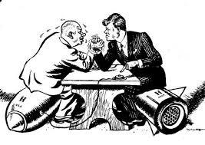
Cuban Missile Crisis
Castro and the USSR were allies
USSR began installing nuclear missile launch sites in Cuba
Missiles could reach every major eastern U.S. city
JFK ordered a blockade on Cuba and ordered the Soviets to remove the missiles
U.S. contemplated invading Cuba
Lasted 2 weeks
Both countries were on the brink of a nuclear war

Slide 34
At last a deal was struck
USSR would remove the missiles if the U.S. promised to leave Cuba alone

Slide 35
Latin America
Nicaragua also led to tensions in the Cold War
Sandinistas: communist rebels who take over and overthrow a U.S. backed dictator
Cuba and Sandinistas begin spreading fear of a domino effect in S. America
U.S. funded a rebel army called the Contras to fight the Sandinistas
Contras were successful and defeated the spread of communism in 1990

Slide 36
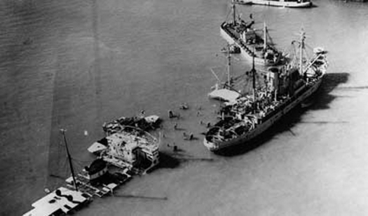
The Middle East During the Cold War
First problems erupt in Egypt
Gamal Abdel Nasser accepted aid from the USSR
He seized the Suez Canal in 1956
Canal was operated by France and Britain
Shortest link between Europe and Asia
France Britain and Israel retook the canal
U.S. feared a Soviet intervention and increased their military presence in the Middle East to secure its oil and supplies

Slide 37
Iran during the Cold War
The United States supported Shah Mohammad Reza Pahlavi
Nationalists rose up against the western backed leader
In 1951 Iran seized a British oil company
Forced the Shah to leave and accepted Soviet aid
U.S. feared a Soviet take over and carried out a covert operation by the CIA

Slide 38
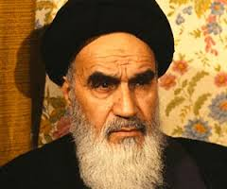
Operation arrested the Prime Minister Mohammed Mossadeq who overthrew the Shah
U.S. reinstated the Shah to power
Over the next 20 years the Shah attempted to modernize Iran
He was overthrown in 1979 by Islamists led by Ayatollah Ruholla Khomeini
Khomeini put in anti-western policies

Slide 39
Islamic revolutionaries held Americans hostage in Tehran from 1971-1981 (444 Days)
Saddam Hussein and Iraq feared the spread of the Islam Revolution in Iran to Iraq
Iran and Iraq fought for 8 years
https://www.youtube.com/watch?v=A8bC1DEYbI4

Slide 40
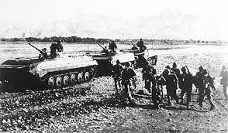
Afghanistan
Soviets invaded Afghanistan to prop up communist government
Civil war broke out and Muslim rebels threatened to topple the gov.
The Soviets helped fight these rebels
U.S. put tough sanctions on USSR and boycotted the 1980 Moscow Olympics
U.S. supplied the Muslim rebels with guns
Like Vietnam the war dragged on and Soviet forces left in 1989

Slide 41
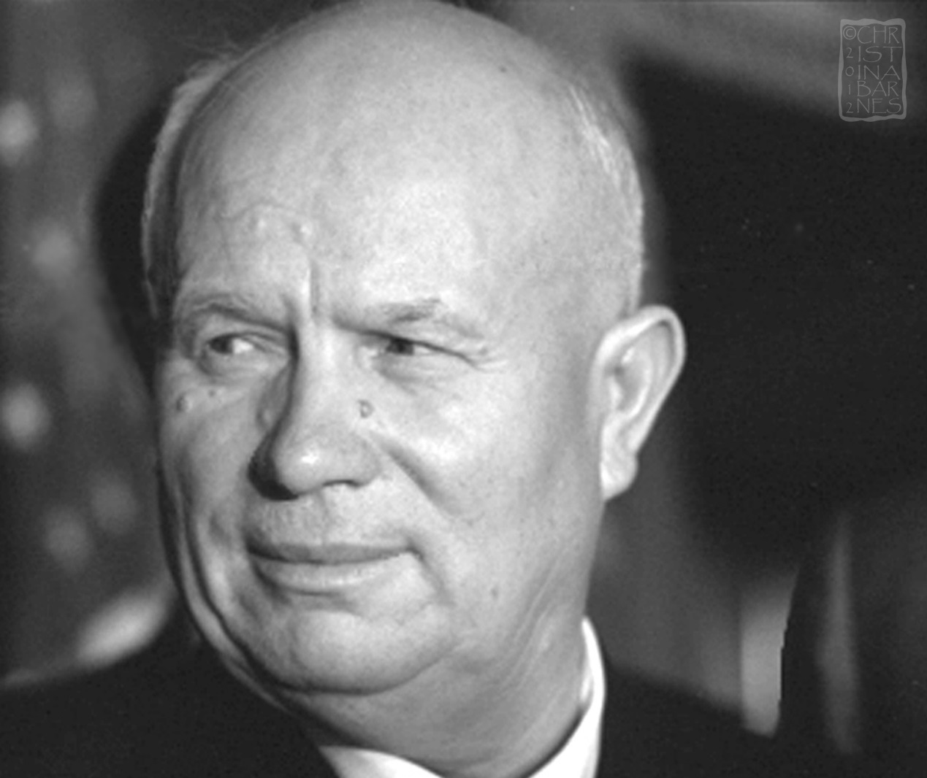
The Cold War Melts
After a while some countries began trying to escape Soviet domination
In 1956 Hungarians revolted against their Soviet backed gov.
New Soviet leader after Stalin died in 1953 was Nikita Khrushev
  Disliked Stalins harsh rule
Khrushev ordered an invasion to crush the rebellion and 20,000 Hungarians died
Evidence was mounting as more people tried to flee communism in Europe

Slide 42
Détente: the easing of Cold War tensions and hostility in the early 1970’s
Brinksmanship: The willingness to use nuclear threats to the brink of war
Brinksmanship and the negative economic impact of the arms race forced the 2 super powers to reduce arms
Strategic Arms Limitation Treaty (SALT) limited the number of nukes each country could have

Slide 43
USSR vs. China
Both wanted to be the worlds top communist leader
China wanted to rival U.S. and USSR’s economy
Mao’s Great Leap Forward
  Set up communes to increase agriculture and industry output
Peasants agreed to communism and communes in the hopes that they would receive land and equal wealth
Poor harvests, starvation and chaos destroyed the communes and the Great Leap Forward
Soviets were clear communist leaders

Slide 44
Problems in the USSR
The problems with Afghanistan led to problems in the Soviet economy and undermined their power
Main issue in the USSR was the economy
State-run economy could not compete with the private enterprise system
Citizens had low standards of living
Basic goods were in low supply
Quality of services (education, health care) was poor

Slide 45
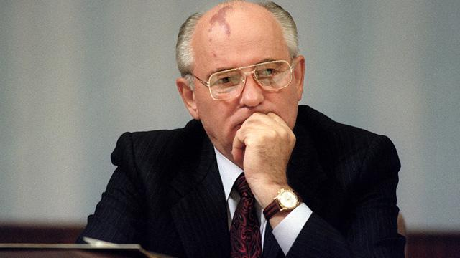
They had less personal freedoms
Mikhail Gorbachev took over in 1985
Wanted to reform the USSR
Wanted to promote a version of communism with a “human face”
Gorbachev’s 2 main reforms
  Perestroika: economic reform adopting some limited free market industries
  Glasnost: openness, encouraged people to voice their opinions and gave more freedom of press

Slide 46
The Cold War Ends
Gorbachev worked with the west to improve relations
President Reagan and Gorbachev worked to control arms and maintain peace
Gorbachevs efforts to improve the economy weren’t working
Perestroika and Glasnost gave people a taste of and they demanded moredemocracy
In 1989 Eastern European countries broke way from the Soviet Union
November 9th, 1989 the Berlin Wall came down
https://www.youtube.com/watch?v=fK1MwhEDjHg

Slide 47
Collapse of the Soviet Union
Germany united in 1990
The Soviet Union collapsed in 1991 and separated into 15 states
  Mostly due to demand for democracy after Perestroika and Glasnost
Countries all across Europe were moving towards democracy
China remained communist and is still the largest communist country today
1989 Chinese protesters were killed at Tiananmen Square
China too opened their economy to more capitalistic practices

